Slide 1
Accessing LINUX
Associate Professor Noraniah Mohd. Yassin
SCSJ1023 – Programming Technique II
Sem. 2 2013/2014

Slide 2
Accessing Linux
Linux can be accessed through dual boot or installed on a VMware workstation
A VMware workstation allows running of multiple operating systems (OS) :
at the same time
On the same computer
In this case - Windows and Linux simultaneously

Slide 3
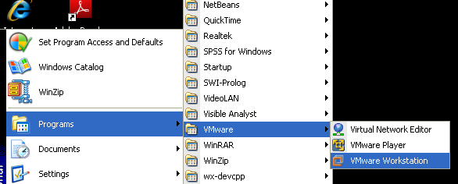
Get VMware

Slide 4
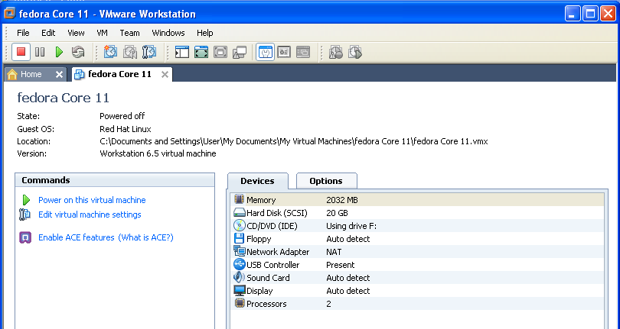
Power on this virtual machine

Slide 5
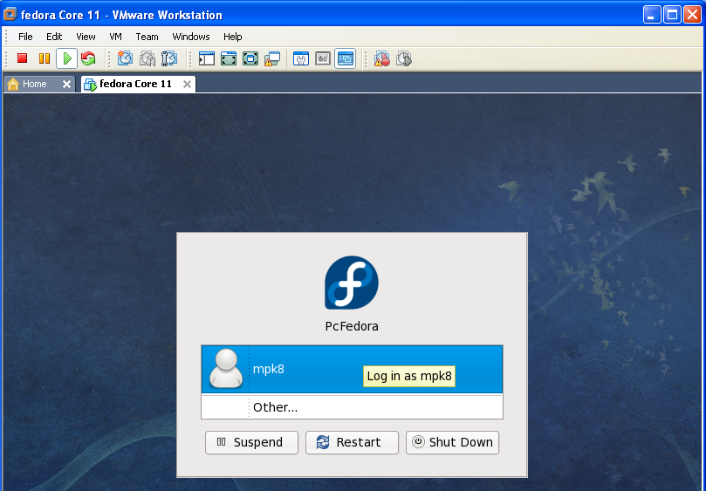
Start-up Window

Slide 6
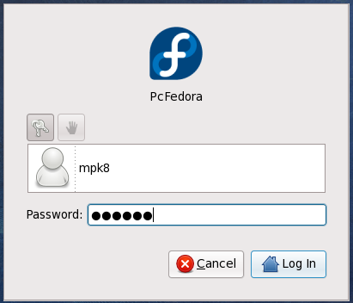
Log-in Window
Log-in ID and Password as in instructions on lab walls

Slide 7
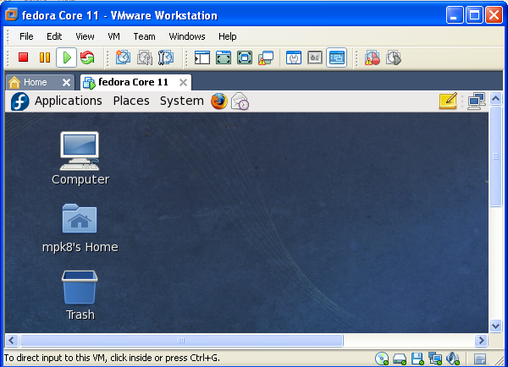
X-Window

Slide 8
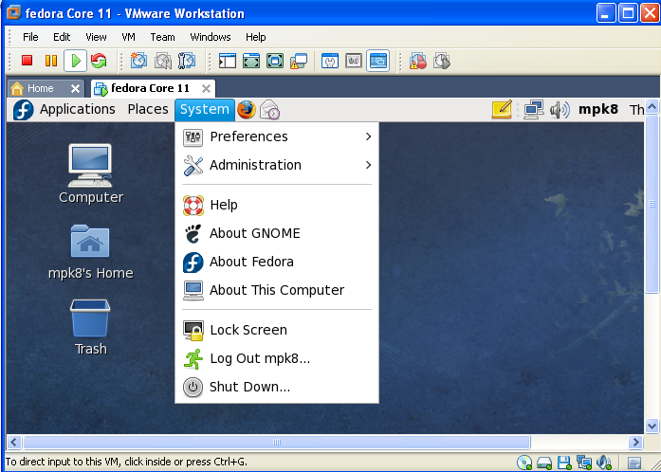
To Shutdown

Slide 9
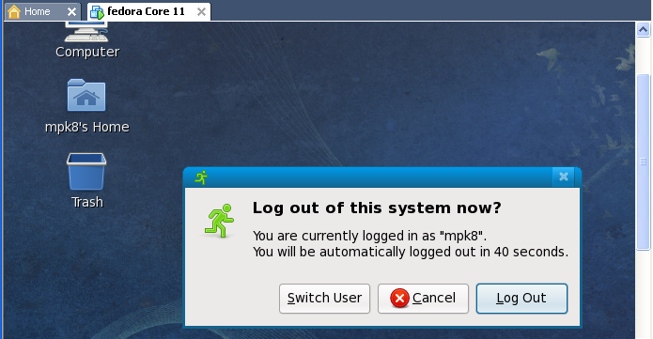
Log Out

Slide 10
Log in again to continue

Slide 11
How to Use The Linux Command Line
Open a terminal window which appears in the System Tools menu.
the command line, also referred to as the shell (although the shell is actually a program the provides the command line)
Commands (and virtually everything else) in Unix-like operating systems are case sensitive
Studying the command line also provides insight into how computers really work.

Slide 12
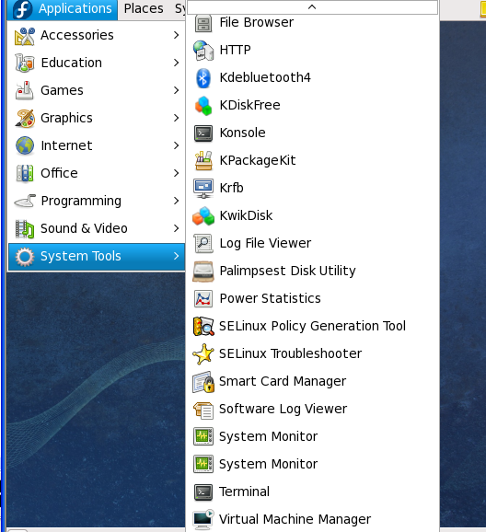
Getting the terminal window
From
“Applications”
menu
choose
“System Tools”,
then
click on
“Terminal”

Slide 13
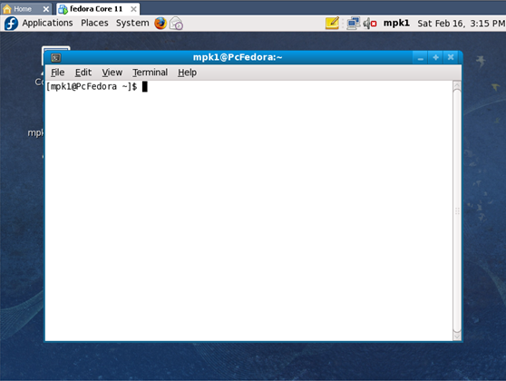
When you get this screen you are ready to interact with your computer using command line instructions. Key-in “exit” to stop.

Slide 14
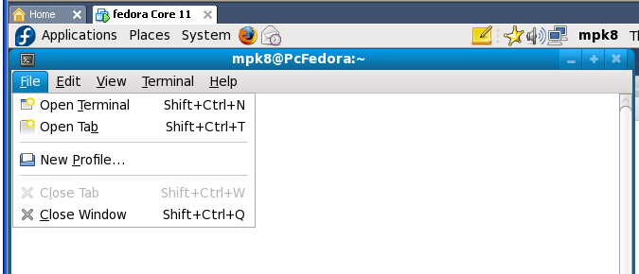
To create multiple windows

Slide 15
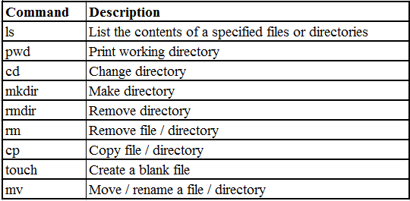
Basic Linux Commands
pwd
ls
cd
touch
mkdir
rm
rmdir
cp
mv

Slide 16
How to Create a First C++ Program in Linux
Normally Linux programmers type their programs by using the vi editor.
(we will skip VI due to time constraints)
You can also you any other GUI or text editors (choose from “Applications”)

Slide 17
Compiling and Running C++ Programs
See related slides

Slide 18
Command Completion and How to Use It
See related slides

Slide 19
Questions and Answers

